Slide 1
MySQL + Hibernate
Alicja Salamon, Dawid Aksamit

Slide 2
O MySQL
był pisany raczej z myślą o szybkości niż kompatybilności ze standardem SQL
Popularny wsród webowych aplikacji – część szeroko rozpowszechnionego LAMP - złożonego open sourcowych: Linux, Apache, MySQL, Perl/PHP/Python
Free-software-open source projects that require a full-featured database management system often use MySQL.Ciekawe cechy, zalety, wady, przeznaczenie -> w wersji 5 dodano procedury składowane, wyzwalacze , widoki
the world's most widely used

Slide 3
O MySQL - wady
Like other SQL databases, MySQL does not currently comply with the full SQL standard for some of the implemented functionality, including foreign key references when using some storage engines other than the 'standard' InnoDB.
Triggers are currently limited to one per action / timing, i.e. maximum one after insert and one before insert on the same table. There are no triggers on views.
MySQL, like most other transactional relational databases, is strongly limited by hard disk performance. This is especially true in terms of write latency.

Slide 4
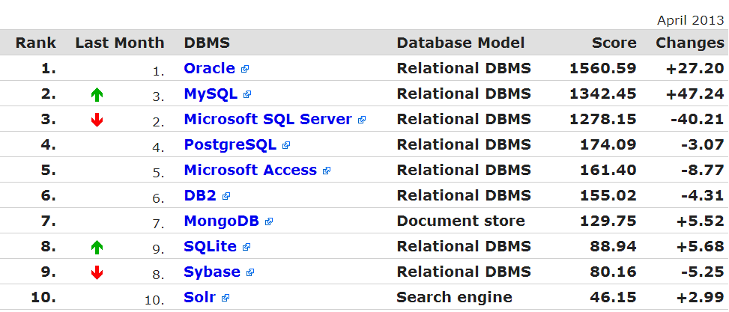
http://db-engines.com/en/ranking
MySQL is also used in many high-profile, large-scale World Wide Web products, including
Wikipedia
Google (though not for searches),
Facebook
Twitter,
YouTube

Slide 5
O Hibernate
Założenia i cele twórców
Ciekawe cechy, zalety, wady, przeznaczenie

Slide 6
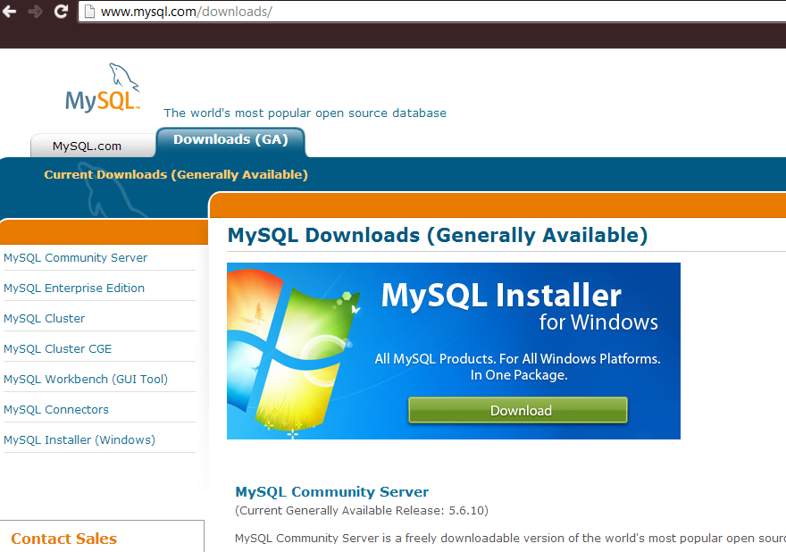
Instalacja MySQL

Slide 7
Instalacja

Slide 8
Instalacja

Slide 9
Konfiguracja

Slide 10
Skąd Hibernate?

Slide 11
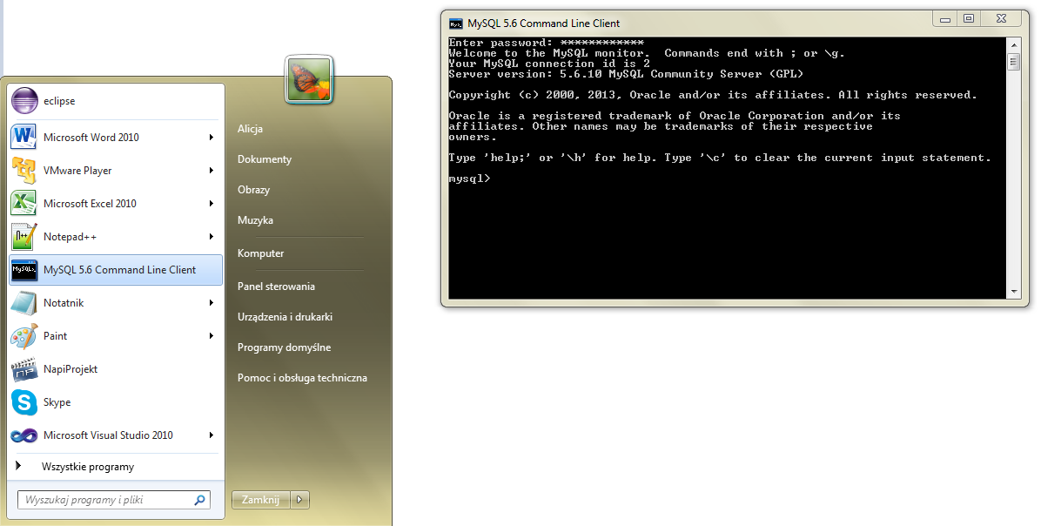
Uruchomienie – command line

Slide 12
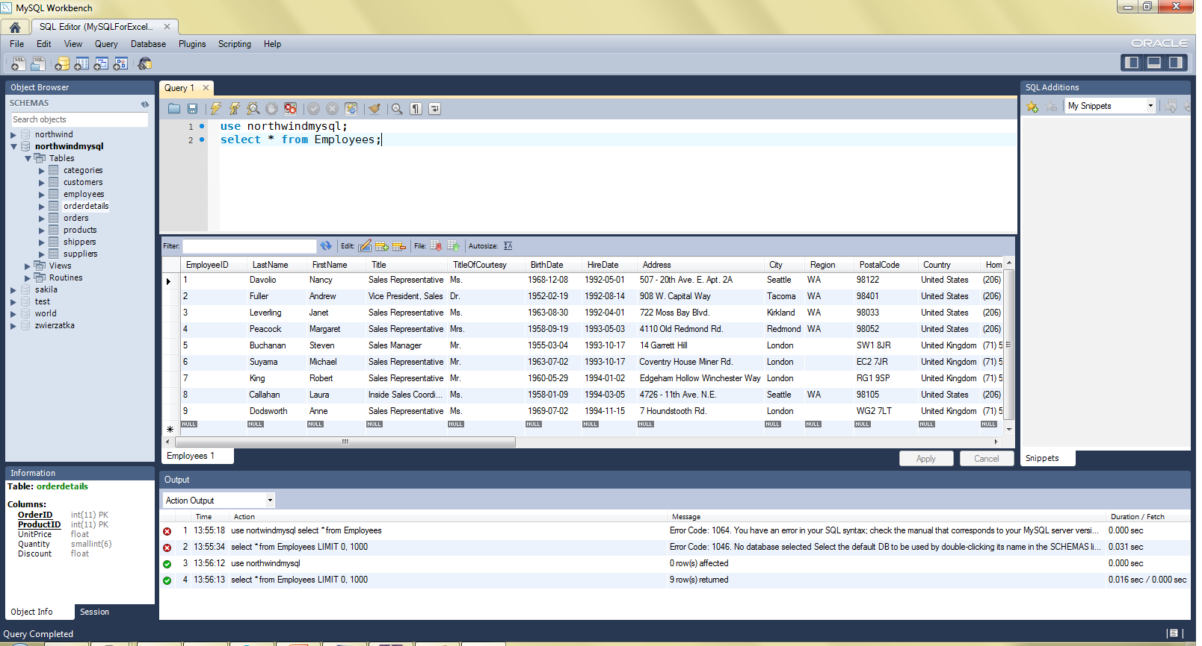
Uruchomienie - Workbench

Slide 13
Tworzenie bazy danych
mysql> CREATE DATABASE northwind;
Query OK, 1 row affected (0.16 sec)
mysql> drop DATABASE nortwind;
Query OK, 0 rows affected (1.28 sec)
mysql> show databases;
+--------------------+
| Database |
+--------------------+
| information_schema |
| mysql |
| northwind |
| test |
| world |
+--------------------+
mysql> USE northwind
Database changed
mysql> show tables;
+--------------------------+
| Tables_in_northwind |
+--------------------------+
| categories |
| customers |
| employees |
| orderdetails |
| orders |
| products |
| shippers |
| suppliers |
+--------------------------+

Slide 14
Tworzenie tabeli
CREATE TABLE Products( ProductID INT NOT NULL AUTO_INCREMENT, ProductName VARCHAR(40) NOT NULL, SupplierID INT NOT NULL, CategoryID INT NOT NULL, QuantityPerUnit VARCHAR(20), UnitPrice FLOAT DEFAULT 0, UnitsInStock SMALLINT DEFAULT 0, UnitsOnOrder SMALLINT DEFAULT 0, ReorderLevel SMALLINT DEFAULT 0, Discontinued TINYINT DEFAULT 0 NOT NULL, FOREIGN KEY (CategoryID) REFERENCES Categories (CategoryID), FOREIGN KEY (SupplierID) REFERENCES Suppliers (SupplierID), PRIMARY KEY (ProductID), INDEX ProductName (ProductName)
)ENGINE=InnoDB;

Slide 15
Opis tabeli
mysql> describe Products;
+-----------------+---------------+------+-----+---------+----------------+
| Field | Type | Null | Key | Default | Extra |
+-----------------+---------------+------+-----+---------+----------------+
| ProductID | int(11) | NO | PRI | NULL | auto_increment |
| ProductName | varchar(40) | NO | | NULL | |
| SupplierID | int(11) | NO | MUL | NULL | |
| CategoryID | int(11) | NO | MUL | NULL | |
| ContactName | varchar(30) | NO | | NULL | |
| QuantityPerUnit | varchar(20) | NO | | NULL | |
| UnitPrice | decimal(10,2) | NO | | NULL | |
| UnitsInStock | smallint(6) | NO | | NULL | |
| UnitsOnOrder | smallint(6) | NO | | NULL | |
| ReorderLevel | smallint(6) | YES | | NULL | |
| Discounted | bit(1) | NO | | NULL | |
+-----------------+---------------+------+-----+---------+----------------+

Slide 16
Wstawianie danych
INSERT INTO `categories`
(`CategoryID`, `CategoryName`, `Description`, `Picture`) VALUES
(1, 'Beverages', 'Soft drinks, beers, and ales', NULL),
(2, 'Condiments', 'Sweet and savory sauces', ''),
(3, 'Confections', 'Desserts, candies, and sweet breads', ''),
(4, 'Dairy Products', 'Cheeses', ''),
(5, 'Grains/Cereals', 'Breads, crackers, pasta, and cereal', ''),
(6, 'Meat/Poultry', 'Prepared meats', ''),
(7, 'Produce', 'Dried fruit and bean curd', ''),
(8, 'Seafood', 'Seaweed and fish', '');
LOAD DATA LOCAL INFILE '/path/data.txt' INTO TABLE Categories LINES TERMINATED BY '\r\n';

Slide 17
Hibernate – dostęp do bazy
Sposób nawiązywania połączenia

Slide 18
Transakcje
Transaction trns = null;
Session session = HibernateUtil.getSessionFactory().openSession();
try {
trns = session.beginTransaction();
//...
session.getTransaction().commit();
} catch (RuntimeException e) {
if (trns != null)
trns.rollback();
e.printStackTrace();
} finally {
session.flush();
session.close();
}

Slide 19
Create…
Customer c = new Customer("AXAMI", "Aksamit INC.");
session.save(c);
Employee e = new Employee("Alicja", "Salamon", "Krakow");
session.save(e);
Order o = new Order(e, c);
session.save(o);

Slide 20
Read…
List<Order> ordersList = newSession
.createSQLQuery("select * from Orders where OrderID=11078")
.addEntity(Order.class).list();
for (Iterator<Order> iter = ordersList.iterator(); iter.hasNext();) {
Order order = (Order) iter.next();
Employee empl = order.getEmployeeID();
Customer cust = order.getCustomerID();
System.out.println(order.getOrderID() + " by "
+ empl.getFirstName() + " " + empl.getLastName() + " for "
+ cust.getCompanyName());
}

Slide 21
Update…
Customer c = new Customer();
c.customerID = "AXAMI";
c.companyName = "Axamit & Sons";
session.update(c);
Employee e = new Employee("Salamon", "Ala", "Krakow");
e.EmployeeID=10;
session.update(e);

Slide 22
Delete…
Order o = new Order();
o.setOrderID(11078);
session.delete(o);
Customer c1 = new Customer();
c1.setCustomerID("AXAMI");
session.delete(c1);
Employee e = new Employee();
e.EmployeeID = 10;
session.delete(e);

Slide 23
Hibernate – dostęp do bazy
Obsługa relacji

Slide 24
Hibernate – dostęp do bazy
Obsługa transakcji

Slide 25
Źródła

